Slide 1
Review of “Sentence Bottleneck Autoencoders from Transformer Language Models”
Tyler Rada, Jacob Rowell, Quinton Velazquez

Slide 2
Background
Ivan Montero, Nikolaos Pappas, and Noah A. Smith proposed an approach that converts a pre-trained transformer language model into a sentence-level autoencoder.
This autoencoder is able to reconstruct its pretraining data. The resulting model improves the performance of the pretrained model on sentence-level tasks while maintaining its performance on multi sentence tasks.

Slide 3
Article Summary
Representation of learning for text via pre-training a language model on a large scale has become a standard starting point for developing NLP systems. This approach stands in contrast to autoencoders, which are also trained on raw text, but with the objective of learning to encode each input as a vector that allows full reconstruction.
The authors explored the construction of a sentence-level autoencoder from a pretrained, frozen transformer language model. They adapted the masked language modeling objective as a generative, denoising one, while only training a sentence bottleneck and a single-layer modified transformer decoder.
They demonstrated that the sentence representations discovered their model achieve better quality than previous methods. The previous methods extracted representations from pretrained transformers on text similarity tasks, an example of controlled generation, and single-sentence classification tasks in the GLUE benchmark. All while using fewer parameters than large pretrained models.

Slide 4
Needed Hardware
For all of the experiments involving base models, the authors used a computation cluster with 5 NVIDIA RTX 2080 TI GPU, 11GB GPU memory, and 128GB RAM.
For large models, we use a computation cluster with 4 NVIDIA TITAN RTX GPUs, 24GB GPU memory and 256GB RAM

Slide 5
Model Description Part 1
The authors created AUTOBOT, a new autoencoder model for learning sentence “bottleneck” (i.e., fixed-size) representations from pretrained transformers that is useful for similarity, generation, and classification
The model has two unique components:
(i) a transformation that uses dot product attention to dynamically pool semantic information from the pretrained model’s hidden states into a sentence bottleneck representation
(ii) a shallow transformer decoder that is modified to operate based on the bottleneck representation

Slide 6

Model Description Part 2
Encoder: The authors chose to keep the original encoder fixed and train a transformation β that will learn to compress H into a single representation z = β(H; θ), with θ being an additional set of parameters to be learned during fine tuning.
Decoder: The Transformer decoder architecture expects hidden representations for every token input from the encoder in order for each output candidate to attend to each input token.
Training considerations: To avoid training the model from scratch, the creators fine tuned it for 100K optimization steps on a pretraining dataset using the base RoBERTa model.The model is trained using an input reconstruction loss by minimizing the negative log-likelihood computed over the reconstructed inputs.

Slide 7
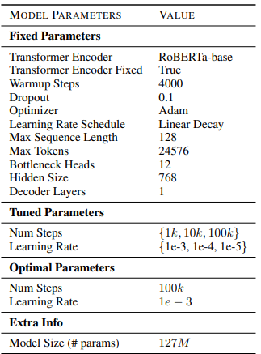
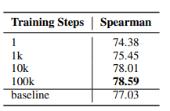
Training For AutoBot

Slide 8
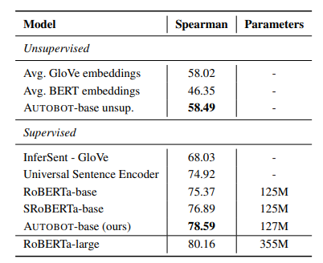
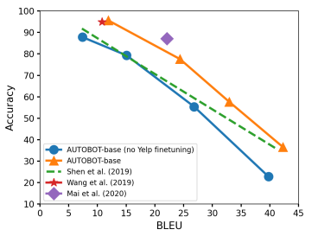
Their Results Part 1

Slide 9
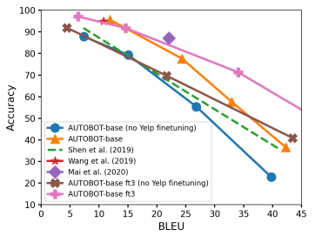
Their Results Part 2

Slide 10
DataSets Used
Since RoBERTa’s Datasets are not available publicly, the team had to use the Datasets that were used to train BERT.
GLUE (General Language Understanding Evaluation)- A collection of nine natural language understanding tasks, including single-sentence tasks CoLA and SST-2, similarity and paraphrasing tasks MRPC, STS-B and QQP, and natural language inference tasks MNLI, QNLI, RTE and WNLI.
CHANGE-IT - dataset contains approximately 152,000 article-headline pairs, collected from two Italian newspapers situated at opposite ends of the political spectrum, namely la Repubblica and Il Giornale.
They also did train the model using Yelp.
Additionally we also used the Dataset found with the TensorFlow website. TensorFlow provides the source code and examples.

Slide 11
Our Original Goals
Download and train the AutoBot model with the same Datasets the Developers used.
Use outside Datasets to further train the model
Replicate the same/similar experiments

Slide 12
What was Easy
The initial installation was fairly simple. All we needed to do was copy the gitHub onto our computers and run a setup line. It took a few minutes for everything to install but it eventually worked.
First Installation took about 1 hour but it worked.
Second Installation using Ubuntu VM only took a few minutes.

Slide 13
What was difficult
Attempting to train the model itself was difficult. We kept running into errors while running the Datasets due to our personal machines not being strong enough.
Another issue we had run into is that if we were to replicate the larger experiments, our computers were not able to handle the information.
Training started off with around 15 hours but then started to throw errors and crashed.
We even tried to use the Ubuntu VM and allocated 60GB of Memory…Still failed.

Slide 14
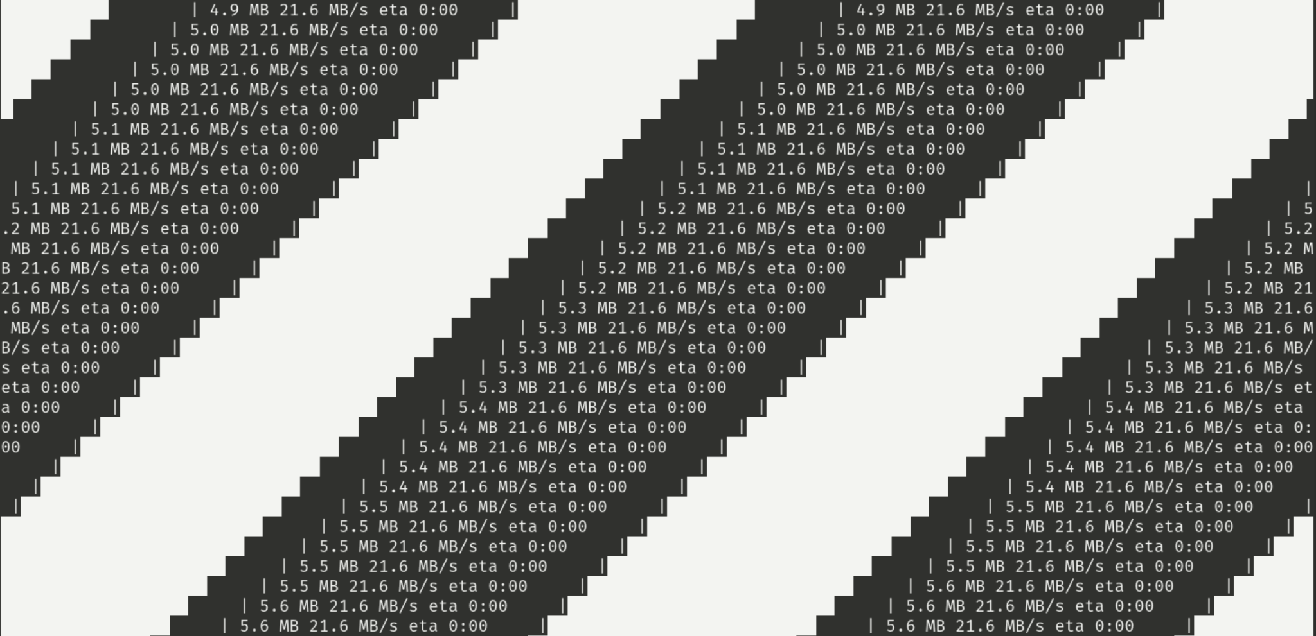

Slide 15
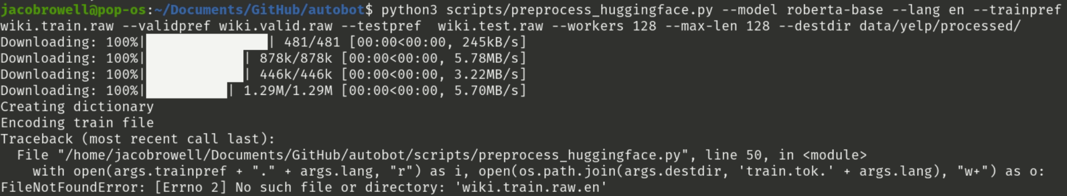

Slide 16
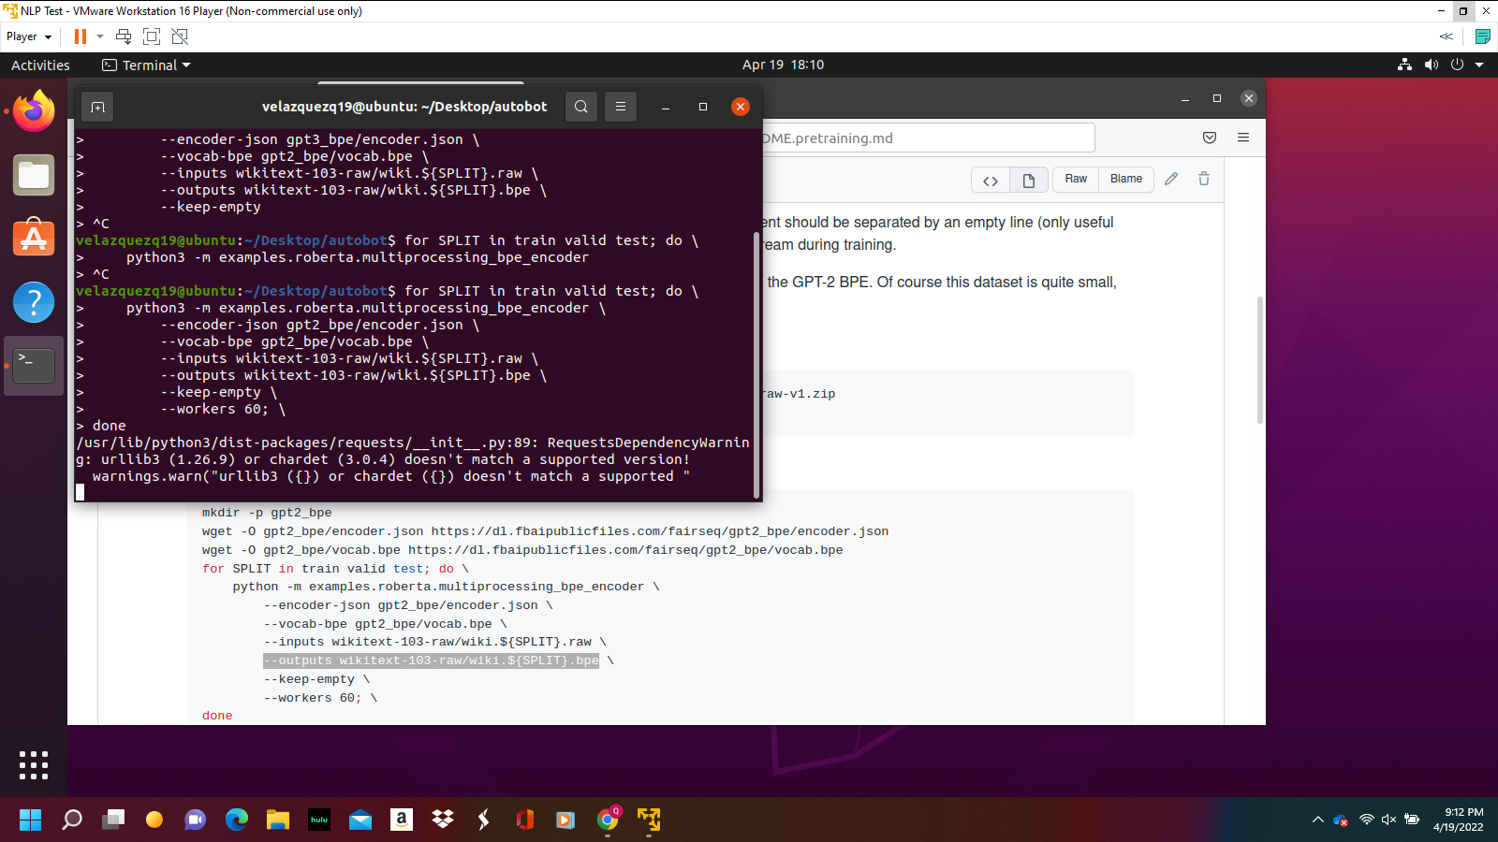

Slide 17
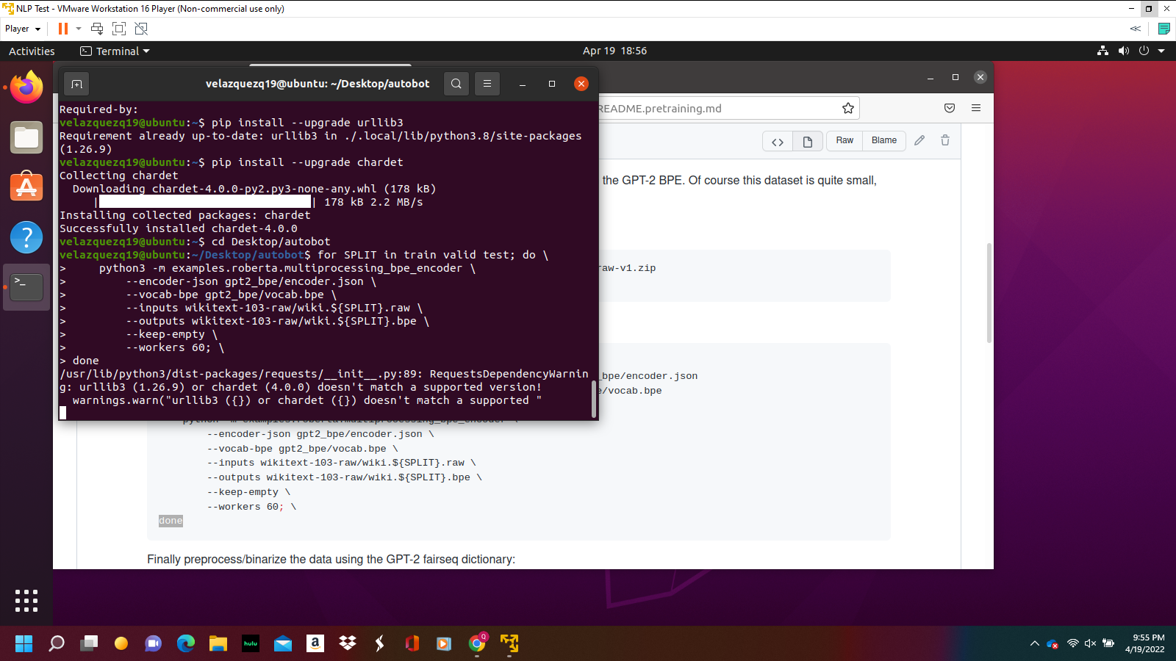

Slide 18
Main Problems
Constant system crashes
Compiling errors
Testing errors

Slide 19
What was actually accomplished
We were able to successfully install Autobot, but when trying to replicate their experiments, our systems just were not powerful enough.
We were not able to fully train our Autobot again due to system requirements.

Slide 20
Resources
Sentence Bottleneck Autoencoders from Transformer Language Models (aclanthology.org)
glue | TensorFlow Datasets
gsarti/change_it · Datasets at Hugging Face
glue · Datasets at Hugging Face
ivanmontero/autobot: Implementation of the paper 'Sentence Bottleneck Autoencoders from Transformer Language Models' (github.com)

